Slide 1
Day 5 7 June, 2024

Slide 2
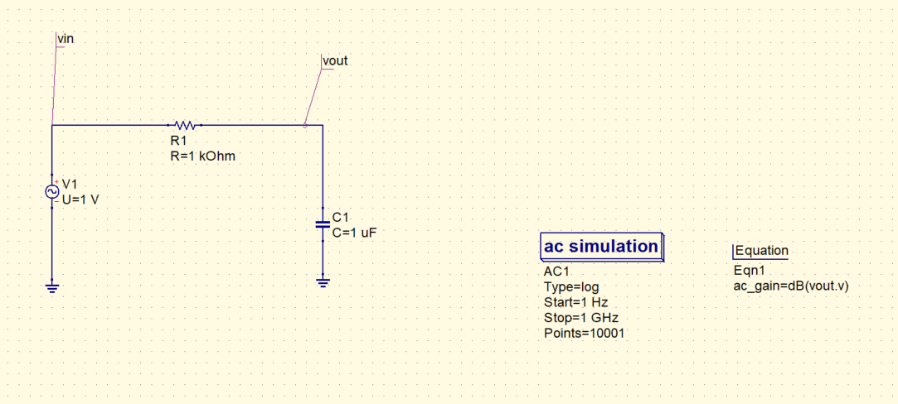
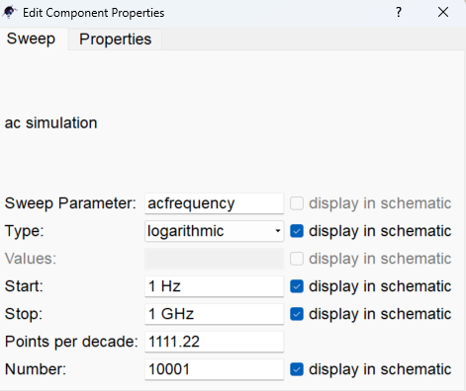
Question: Understanding first order RC low pass filter.

Slide 3
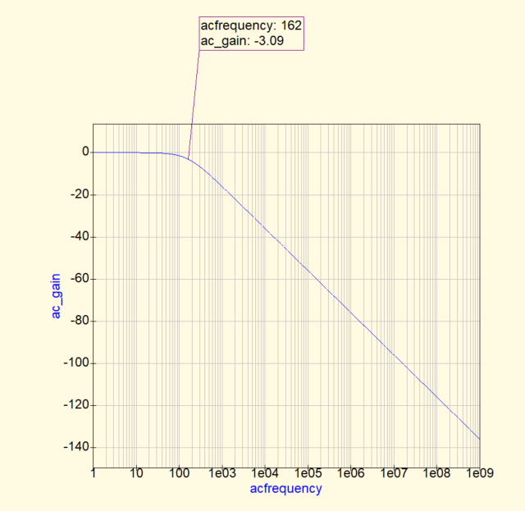
QUCS result
Cutoff frequency = 159 Hz here.

Slide 4
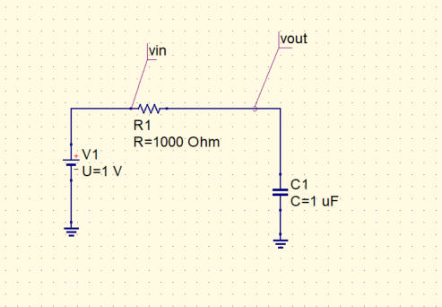
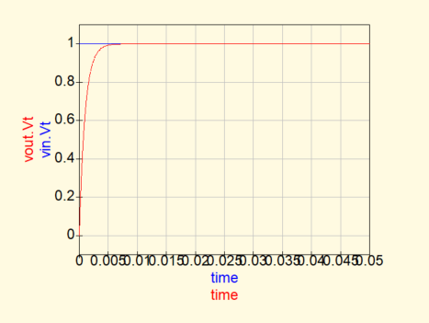
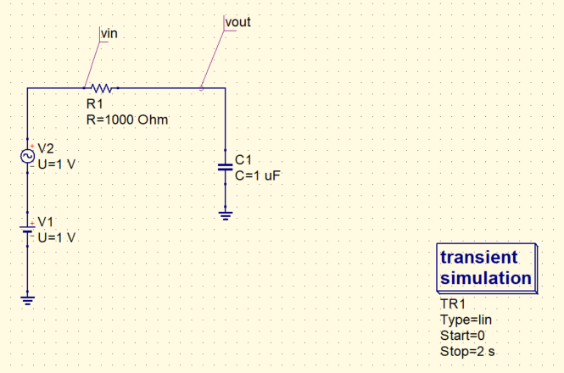
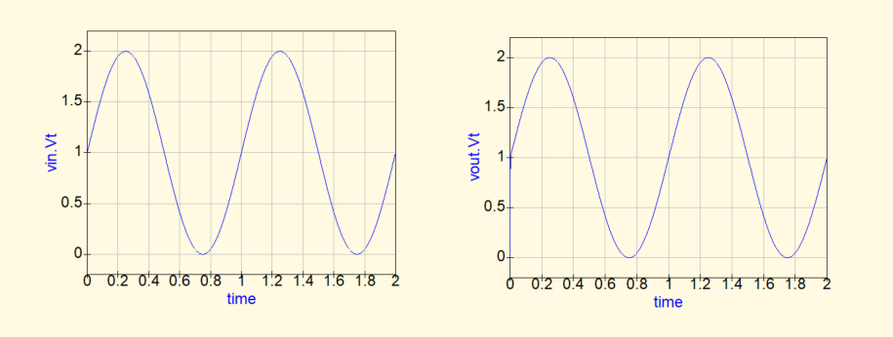
DC Component fully passed
f = 1Hz smoothly passed

Slide 5
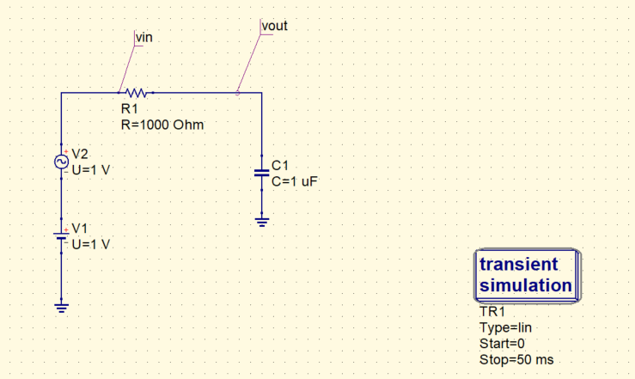
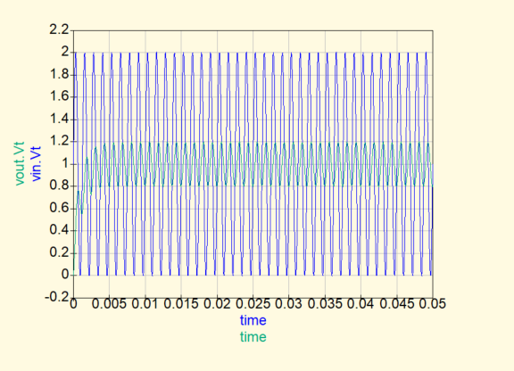
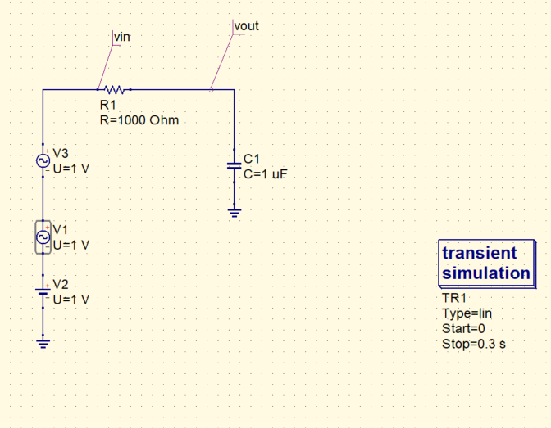
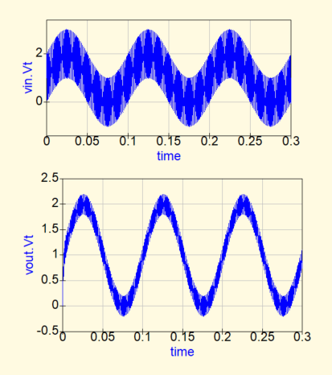
f = 800 Hz is rejected well by the filter
f = 10 Hz is passed, and f = 800 Hz comes as a small ripple on the output

Slide 6
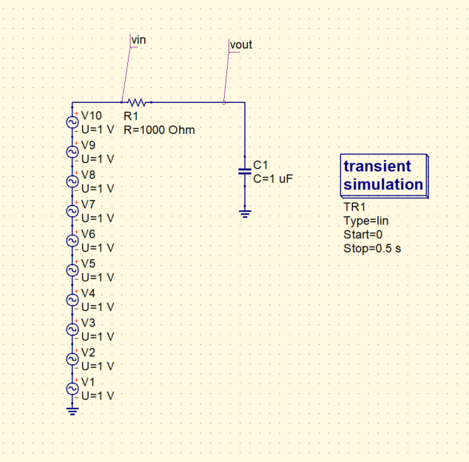
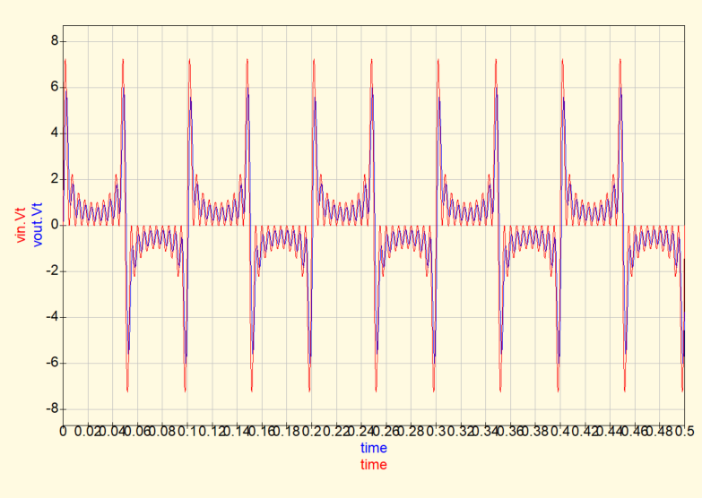
Input given is sum of sinusoidals of fundamental frequency = 10 Hz, and its odd harmonics.
We can alter the cutoff frequency of the low pass filter and check how the filter rejects frequency components much greater than its cutoff frequency.

Slide 7
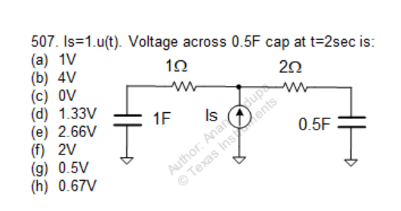
Question

Slide 8
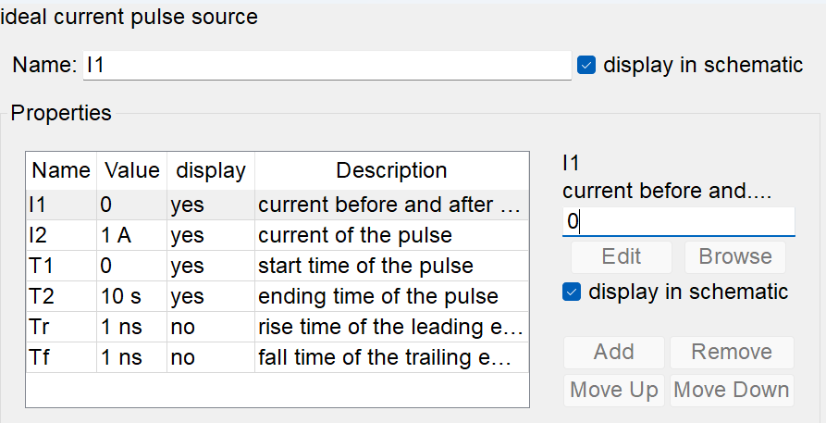
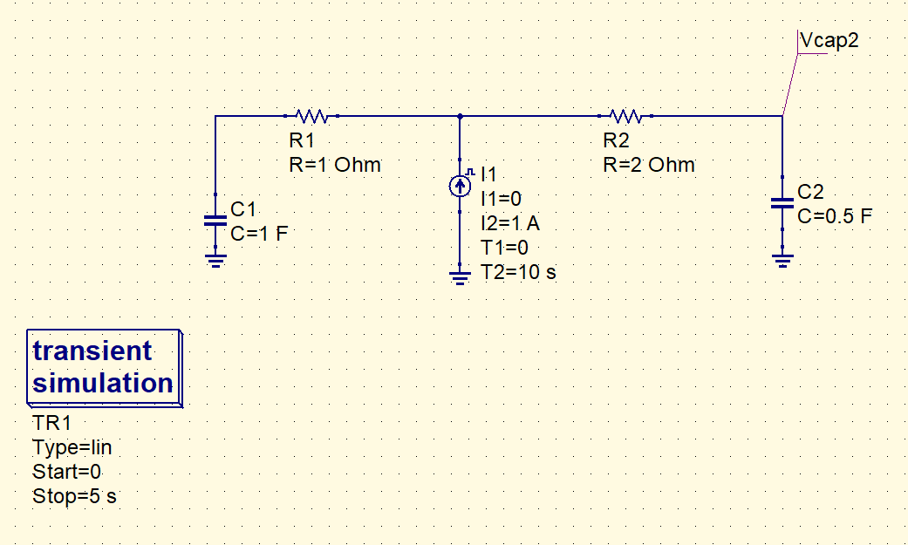
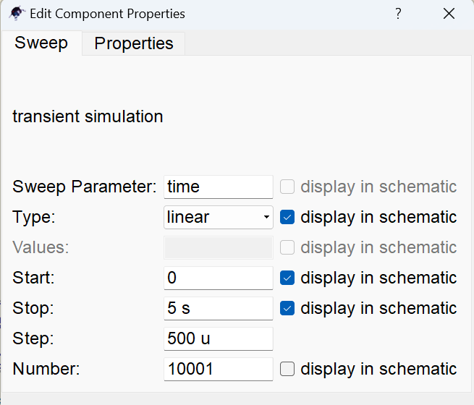
QUCS circuit
Now, change the current value to Is = 2.u(t), what do you expect?
How about Is = α. u(t) ?

Slide 9
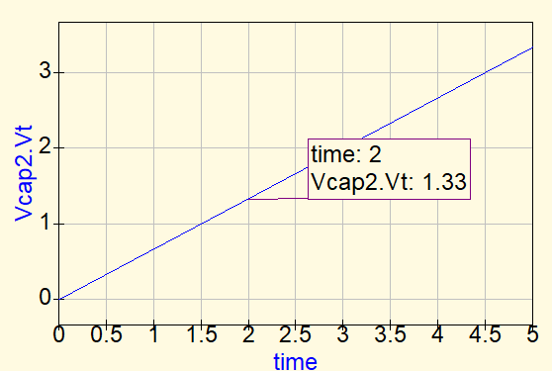
QUCS result
Conclusion:
It can be seen that the impedance looking right of the current source is always twice of the impedance seen towards the left.
Hence, the current Is will always divide in the same proportion, that is one third of it goes in the right branch, and two thirds in the left branch.
A step current being pumped in the cap, the voltage rises like a ramp, and it is given by : Vcap2(t) =(Is/3* t )/0.5C . At t=2s, Vcap2 comes out to be 1.33V
When Is = α. u(t) , Vcap2(t) =(α.Is/3* t )/0.5C

